Slide 1
SQL Joins

Slide 2
What is SQL Join?
The Join Clause combines rows from two or more tables
It creates a set of rows in a temporary table
EQUI JOIN
EQUI JOIN is a simple SQL join.
Uses the equal sign(=) as the comparison operator for the condition
NON EQUI JOIN (not used in practice)
NON EQUI JOIN uses comparison operator other than the equal sign.
The operators uses like >, <, >=, <= with the condition.

Slide 3
Types of SQL Joins
INNER JOIN
LEFT JOIN OR LEFT OUTER JOIN
RIGHT JOIN OR RIGHT OUTER JOIN
FULL OUTER JOIN
CROSS JOIN
SELF JOIN
NATURAL JOIN

Slide 4
Inner Join
A | M
1 | m
2 | n
4 | O
A | N
2 | P
3 | q
5 | R
The INNER JOIN selects all rows from both participating tables as long as there is a match between the columns.
An SQL INNER JOIN is same as JOIN clause, combining rows from two or more tables.
Table A
Table B
Example: INNER JOIN
SELECT * FROM table_A
INNER JOIN table_B
ON table_A.A=table_B.A;
A | M | A | N
2 | n | 2 | p

Slide 5
Left Outer Join
A | M
1 | m
2 | n
4 | O
A | N
2 | P
3 | q
5 | R
The SQL LEFT JOIN, joins two tables and fetches rows based on a condition, which are matching in both the tables.
The unmatched rows from the table to the left of the = sign will also be present in the output table.
Table A
Table B
SELECT * FROM table_A LEFT JOIN table_B
ON table_A.A=table_B.A;
A | M | A | N
2 | n | 2 | P
1 | M | NULL | NULL
4 | O | NULL | NULL

Slide 6
RIGHT Outer Join
A | M
1 | m
2 | n
4 | O
A | N
2 | P
3 | q
5 | R
The SQL RIGHT JOIN, joins two tables and fetches rows based on a condition, which are matching in both the tables.
The unmatched rows from the table to the right of the = sign will also be present in the output table.
Table A
Table B
SELECT * FROM table_A RIGHT JOIN table_B
ON table_A.A=table_B.A;
A | M | A | N
2 | n | 2 | P
NULL | NULL | 3 | Q
NULL | NULL | 5 | r

Slide 7
FULL OUTER JOIN
A | M
1 | m
2 | n
4 | O
A | N
2 | P
3 | q
5 | R
Combines the results of both left and right outer joins
Returns all matched or unmatched rows
Includes tables on both sides of the join clause.
Table A
Table B
SELECT * FROM table_A FULL OUTER JOIN table_B ON table_A.A=table_B.A;
A | M | A | N
2 | n | 2 | P
NULL | NULL | 3 | Q
NULL | NULL | 5 | R
1 | M | NULL | NULL
4 | O | NULL | NULL

Slide 8
SQL CROSS JOIN (Cartesian Product)
A | M
1 | m
2 | n
4 | O
A | N
2 | P
3 | q
5 | R
The SQL CROSS JOIN produces a result set which is the number of rows in the first table multiplied by the number of rows in the second table, if no WHERE clause is used along with CROSS JOIN.
If, WHERE clause is used with CROSS JOIN, it functions like an INNER JOIN.
Table A
Table B
SELECT * FROM table_A
CROSS JOIN table_B;
A | M | A | N
1 | M | 2 | P
2 | N | 2 | P
4 | O | 2 | P
1 | M | 3 | Q
2 | N | 3 | Q
continues

Slide 9
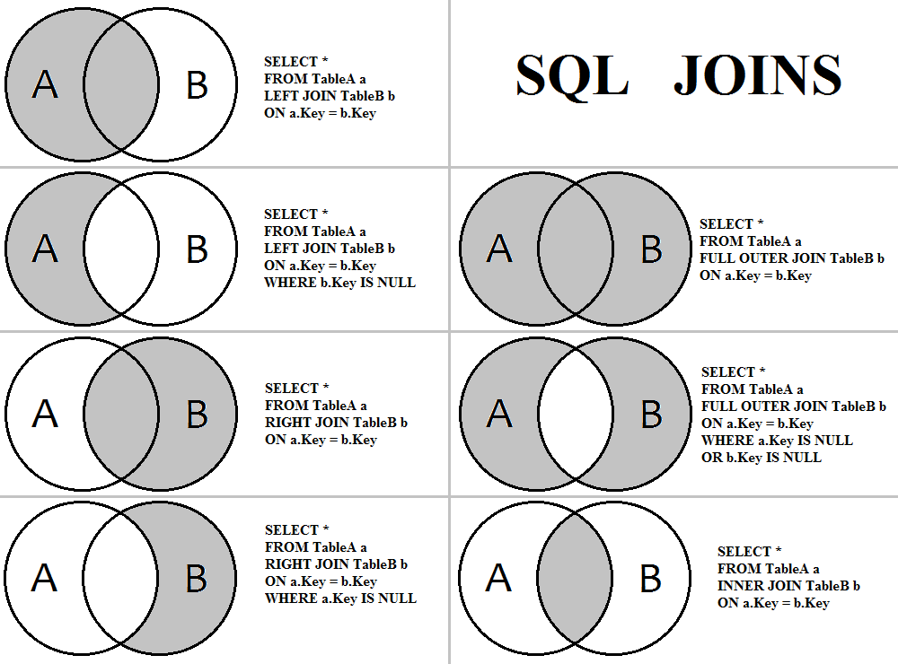

Slide 10
Union vs Join
Union – Allows us to add many similar data sets to create a resulting set that contains the data from multiple sources.
Union does not require any condition for joining
Select “ID”, “NAME” from Turtles
UNION
SELECT “ID”, “NAME” from Ninja_Turtles
Join – Allows us to join records on different tables based on given conditions between many tables.
Select * from Turtles t
INNER JOIN
Ninja_Turtles nt
on nt.Name=t.Name

Slide 11
Set operators (UNION, UNION ALL, MINUS, INTERSECT) [SQL]
select col_1, col_2, col_3, ... col_n from table_1 set operator
select col_1, col_2, col_3, ... col_n from table_2 set operator
... ... select col_1, col_2, col_3, ... col_n from table_n;
The four set operators union, union all, intersect and minus allow to serially combine more than one select statements. Although more than one select statement will then be present, only one result set is then returned.

Slide 12
For the demonstration of set operators, the following test tables are created:
create table table_1 ( col_1 number, col_2 varchar2(10), col_3 date );
create table table_2 ( col_1 number, col_2 varchar2(10), col_3 date );

Slide 13
Then, a few values are inserted:
insert into table_1 values ( 3, 'hello' , to_date('28.08.1970'));
insert into table_1 values ( 42, 'galaxy', to_date('01.01.2001'));
insert into table_1 values (100, 'bye' , to_date('09.02.2004'));
insert into table_2 values ( 3, 'bye' , to_date('28.08.1970'));
insert into table_2 values ( 42, 'galaxy', to_date('01.01.2001'));
insert into table_2 values ( 60, 'bye' , to_date('09.02.2004'));
insert into table_2 values ( 3, 'hello' , to_date('05.05.2002'));

Slide 14
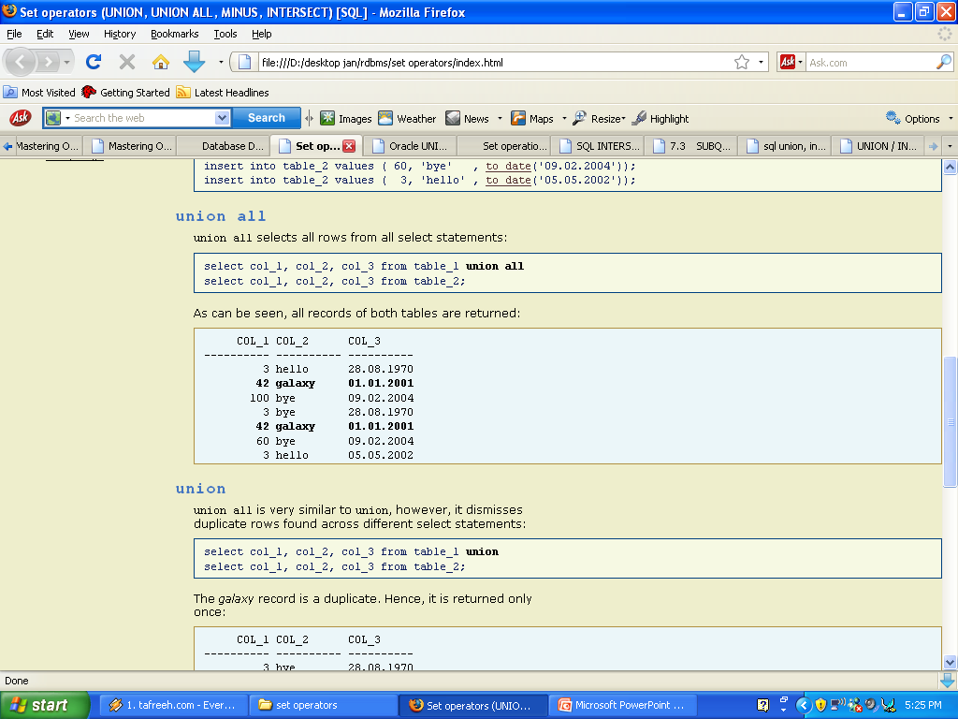

Slide 15
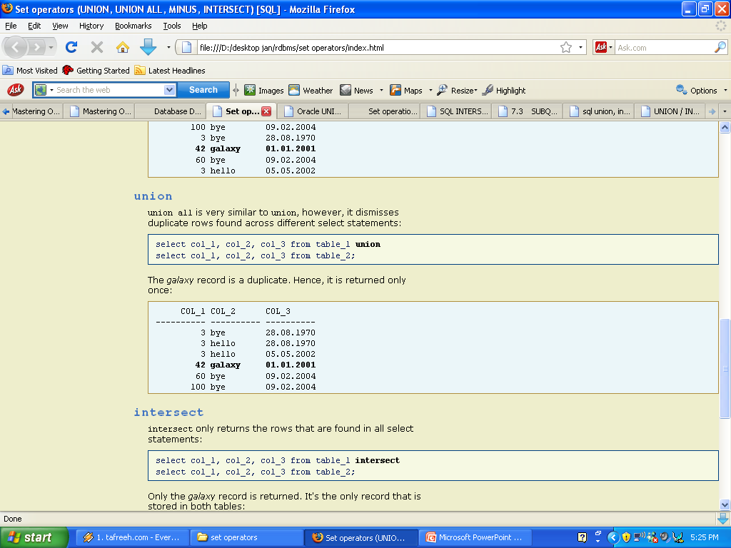

Slide 16
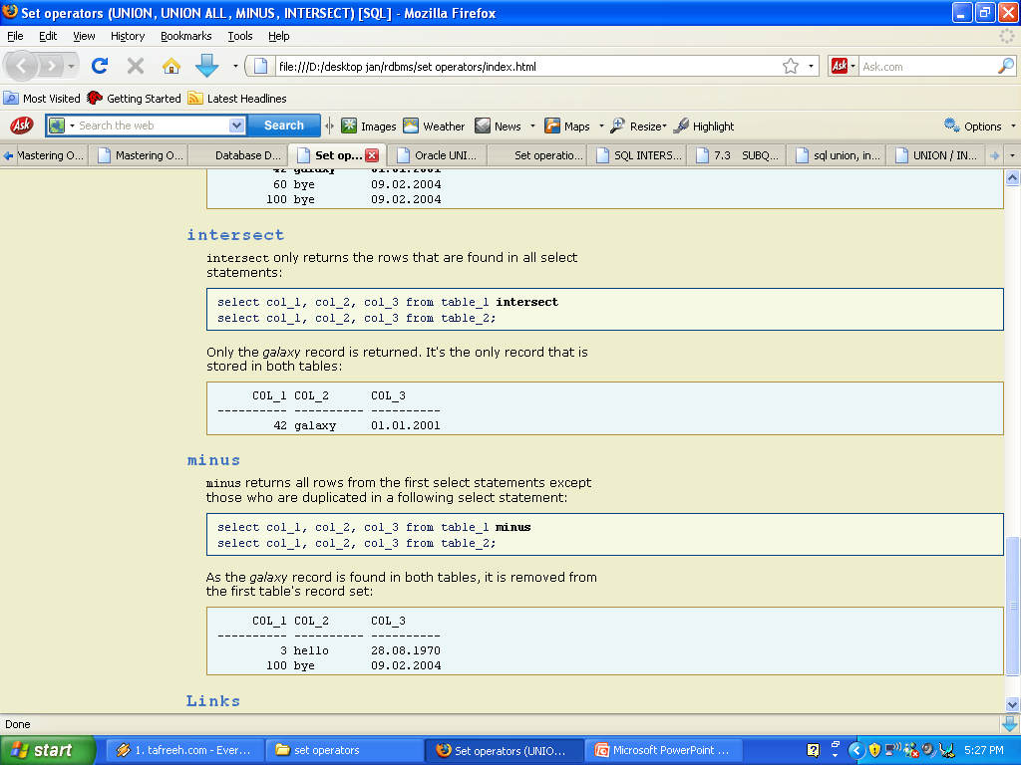

Slide 17
